Slide 1
Hospitality Analysis
End-to-End Data Analysis & Visualization using SQL & BI Tools
Presented by
Divya Chauhan
Nazuka Pol
Nadim Ansari
Harshit
Devinder Singh
Hema Nandhini

Slide 2
Project Overview
Objective : To uncover business insights and key trends in hotel performance using data-driven analysis.
Tools Used :
Excel – Data Cleaning & Modelling
Power BI – Interactive dashboards with DAX
Tableau – Advanced visuals & mapping
SQL - Backend Data Preperation

Slide 3
Key Performance Indicators
Revenue Performance
Booking Trends
Occupancy Analysis
Cancellation Analysis
Room Category & Class Performance
Booking Platform Performance
Hotel & City wise Analysis
Weekday vs Weekend Analysis

Slide 4
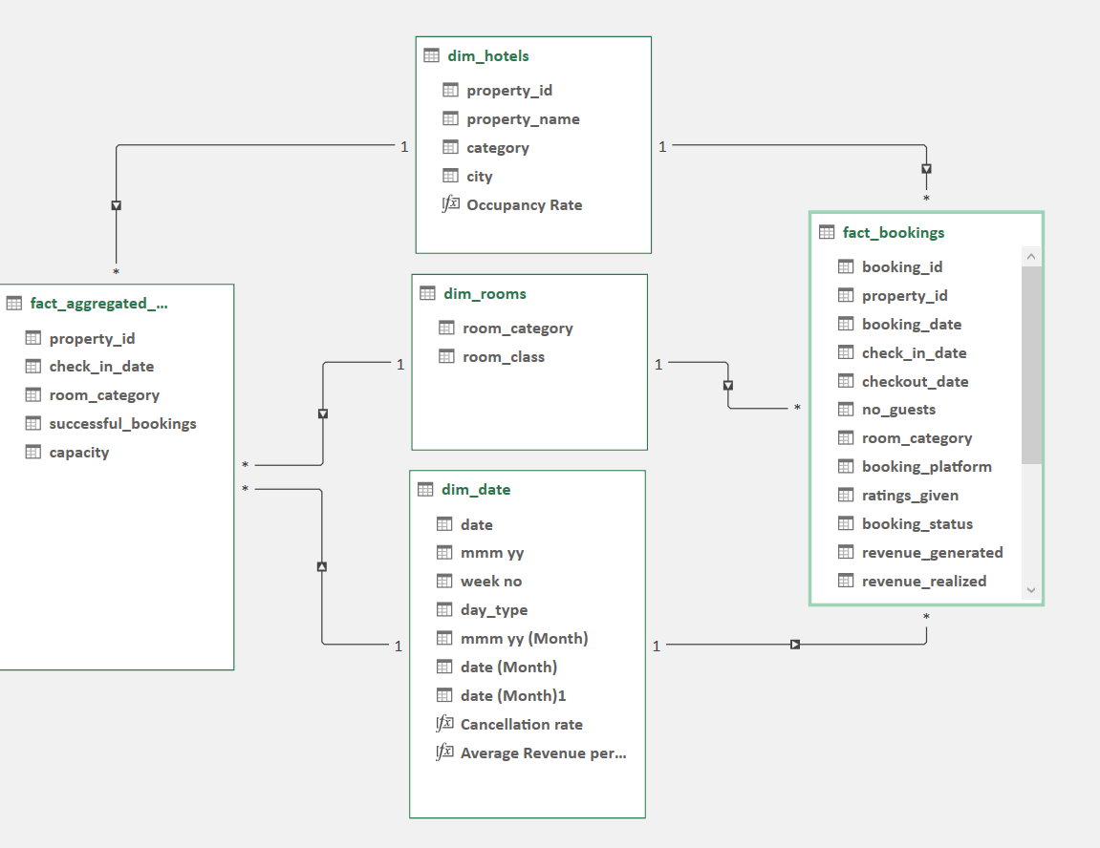
Data Modelling [ Diagram ]
The diagram follows a star schema with two fact tables ‘Bookings’ & ‘Aggregated Bookings’ and three dimension tables ‘Date’ , Room’ & ’Hotels’
All tables are connected through many to one relationship enabling seemless reporting and aggregation

Slide 5
Dashboard Summary
This dashboard provides an overview of hospitality performance through:
City wise booking distribution
Revenue breakdown by room category
Hotel wise revenue across cities
Booking platform segmentation
Customer Rating spread
Weekday vs Weekend Revenue and Total Bookings

Slide 6
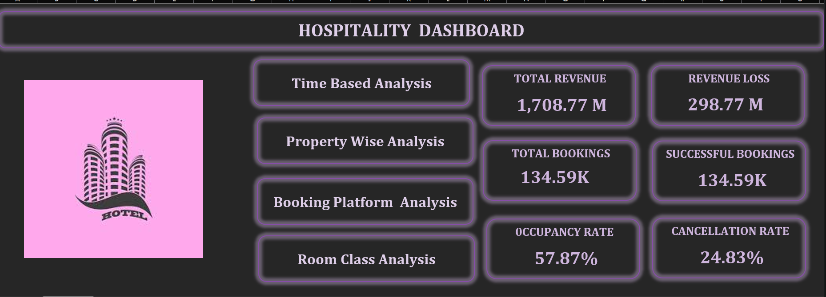

Slide 7
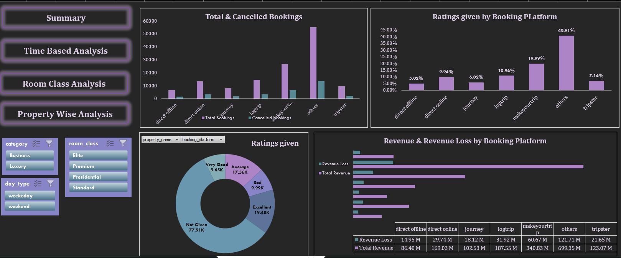

Slide 8
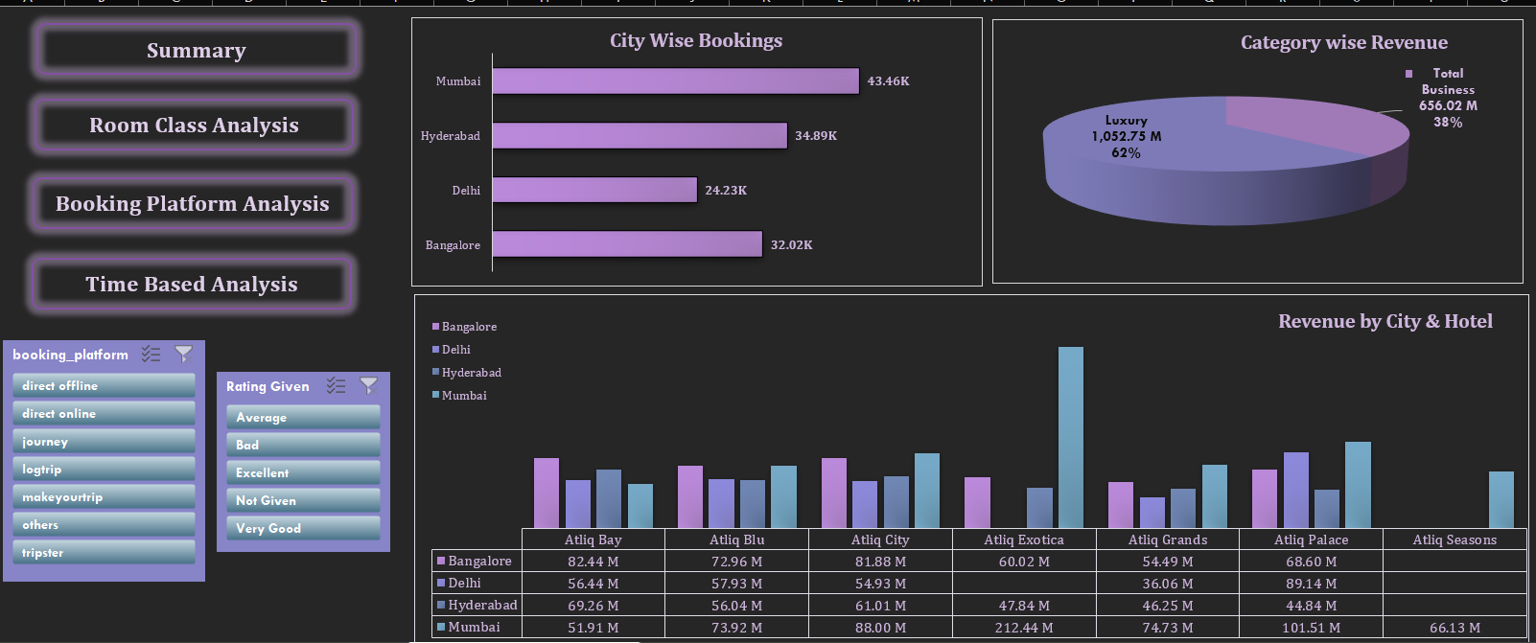

Slide 9
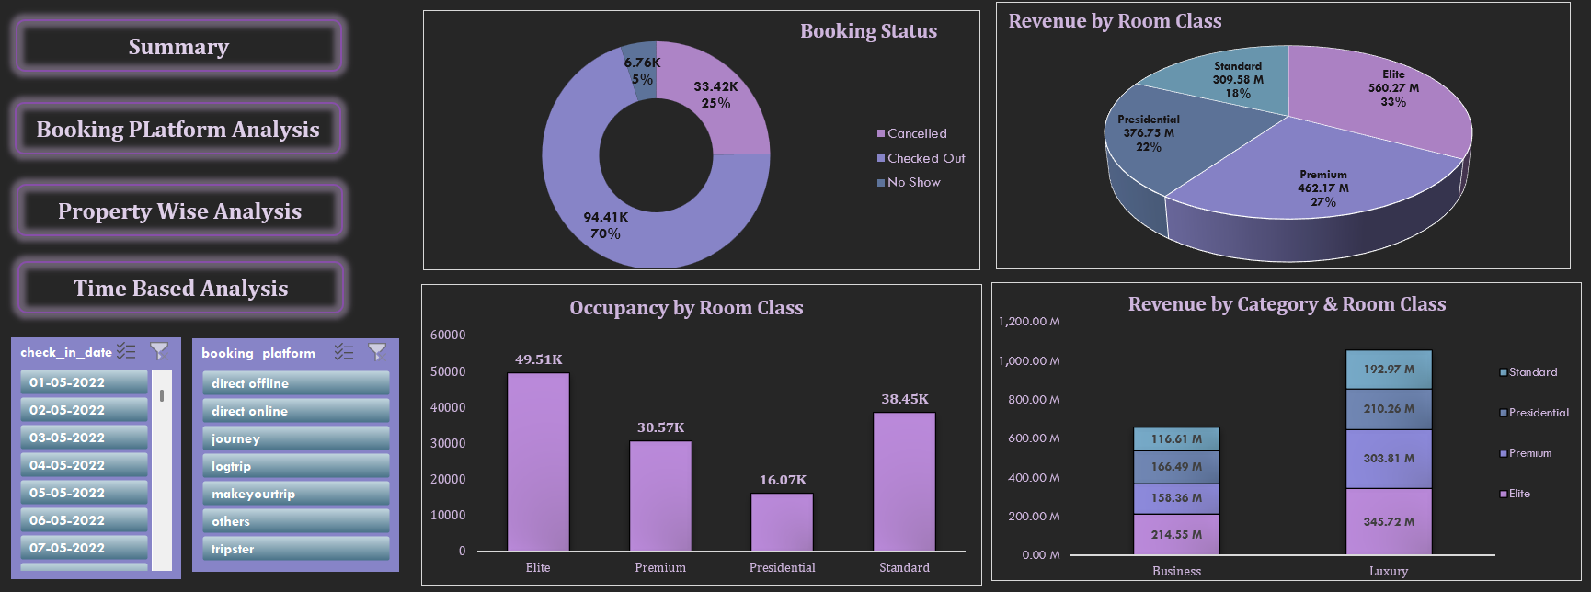

Slide 10
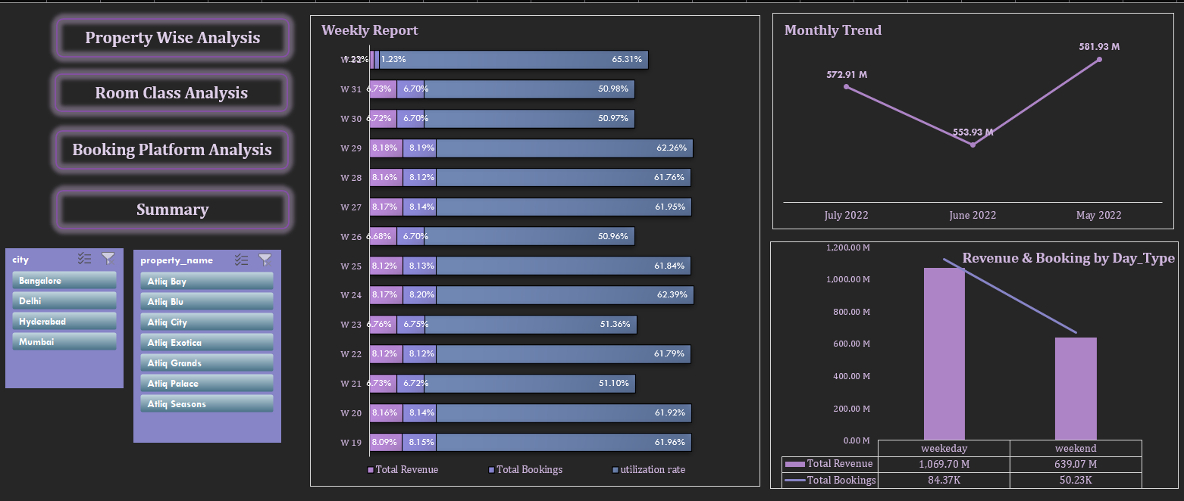

Slide 11
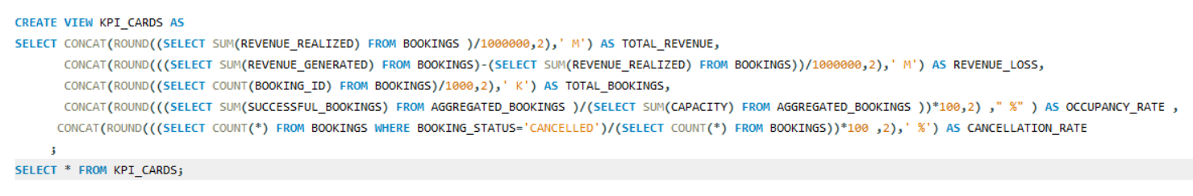
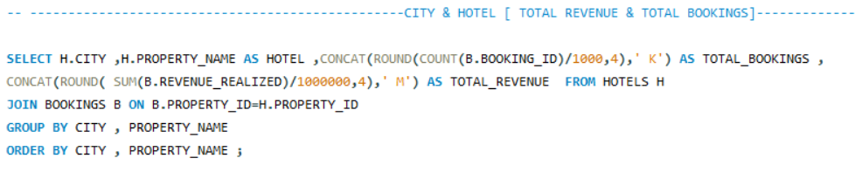
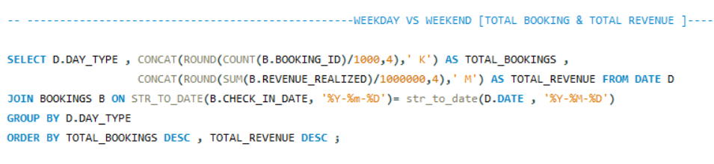

Slide 12
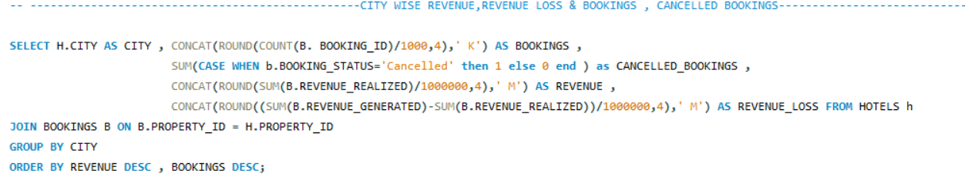
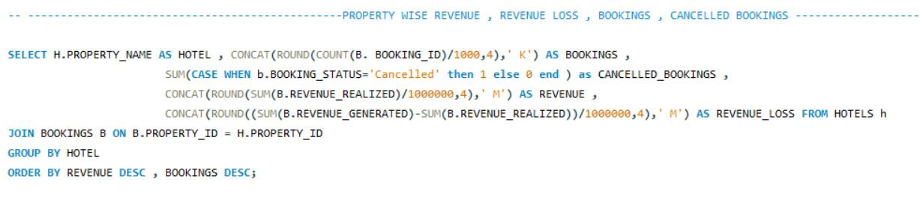

Slide 13
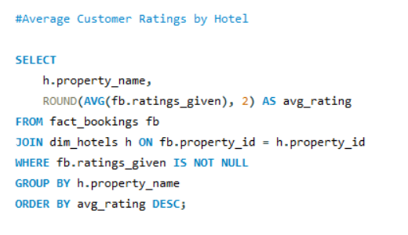
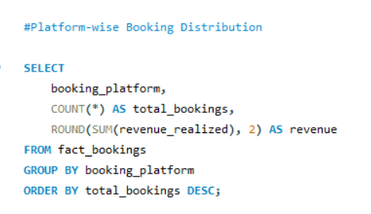
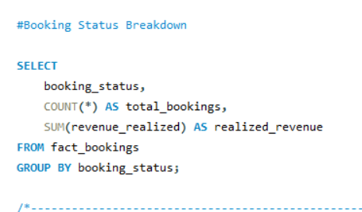
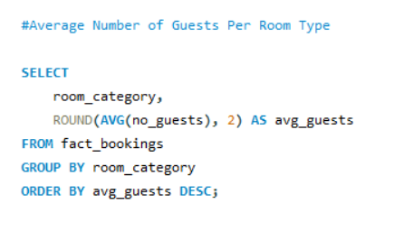

Slide 14
Key Insights
Mumbai had the highest bookings(43.46K),followed by Hyderabad , Bangalore and Delhi.
Luxury rooms generated the majority of revenue (1,052.75 M,62%) whereas Business Category generated revenue (656.02 M , 38%)
Atliq Exotica in Mumbai was the top performing hotel with 212.44 M in revenue .
Direct and third party platforms like ‘Make my Trip’ and ‘Tripster’ are widely used ,indicating need for omni channel strategy.
Customer Ratings very widely emphasizing importance of feedback capture and quality improvement.

Slide 15
Business Recommendations
Balance weekday promotions to boost occupancy.
Reduce cancellation rate via prepayment offers.
Increase suite room marketing in high revenue cities.
Monitor performance using BI dashboards monthly.

Slide 16
Future Enhancements
Integrate real time data updates for live dashboarding.
Add customer feedback data for sentiments based insights.
Automate data quality checks and anomaly detection.
Implement predictive analysis for occupancy and revenue forecasting.
Expand dashboard to include year over year comparisons and competitor benchmarks .

Slide 17
Challenges
Missing and inconsistent data ( e.g. booking status , room types , rating).
Complex joins required to maintain relationship across fact and dimension tables.
Cancellation Handling affected revenue and occupancy calculations
Time based Analysis ( weekday vs weekend , monthly trends ) needed special logic ).
Query performance issues when working with large datasets.
Lost connection while running query of stored procedure because of complex joins and using group by clause on multiple columns .

Slide 18
Thank You
Thank You !
Please feel free to ask any questions!

